Slide 1


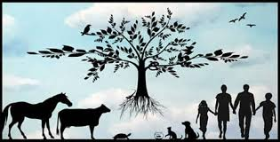
Practical meat hygiene
Stage: 5th
شعار الكلية
Examining the viscera and judgement
Lecture prepared
By
Sara S. Mohammed
Department of Veterinary Public Health
College of veterinary medicine
university of basrah
University of Basrah- College of veterinary medicine-

Slide 2
Introduction
Routine post-mortem examination or inspection is based on the examination of heads and their lymph nodes, thoracic and abdominal viscera and their lymph nodes, and the exposed parts of the carcass.
The inspection is made of organs and body lymph nodes, when significant abnormalities are observed during routine examination .

Slide 3
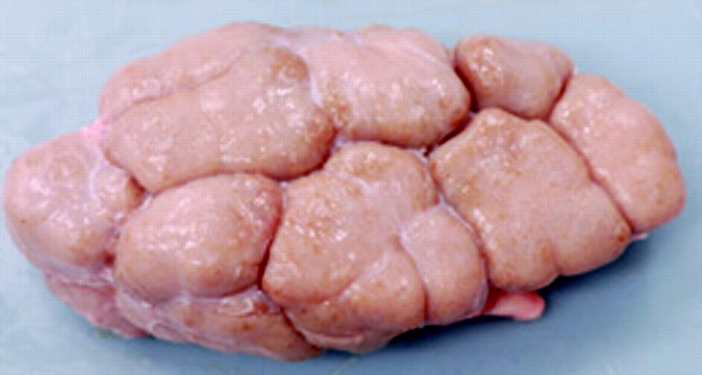
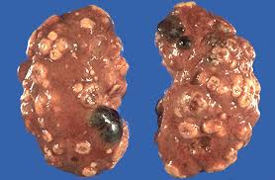
Kidneys normally remain attached to the carcass for inspection, which is conducted by visual inspection and palpation.
Only if any abnormality is detected should the renal lymph nodes be cut open to detect nephritis.
Inspection of kidneys

Slide 4
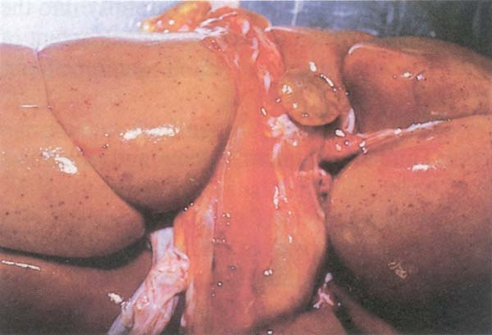
Serous atrophy of renal fat. Note petechial haemorrhages, seen frequently in septicemic diseases.

Slide 5
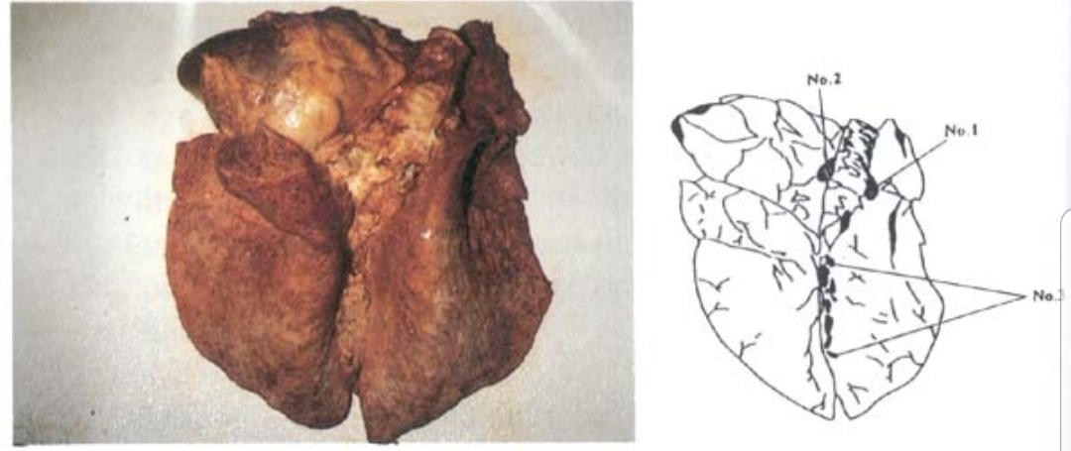
Inspection of lungs
1- Visual inspection for pneumonia, cysts (e.g. hydatid), abscesses, tumours, etc.;
2- palpation to detect any of the above within deeper tissue;
Incision and examination of bronchial, mediastinal pairs of lymph nodes (note: tuberculosis can be diagnosed in these lymph nodes); and • Incision to open trachea and lower airways to examine for inflammation and foreign contents (food, parasites, blood, etc.) or partially swallowed food.

Slide 6
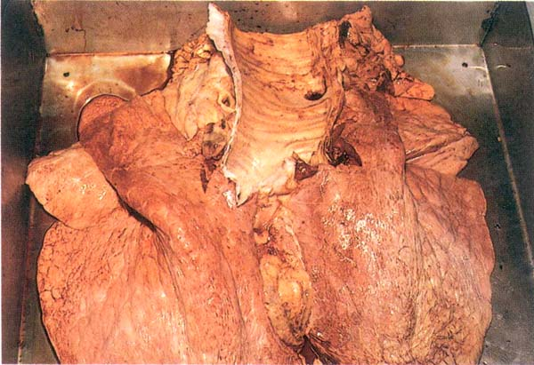
Lung inspection in buffalo - Open trachea and incised bronchial and mediastinal lymph nodes.

Slide 7
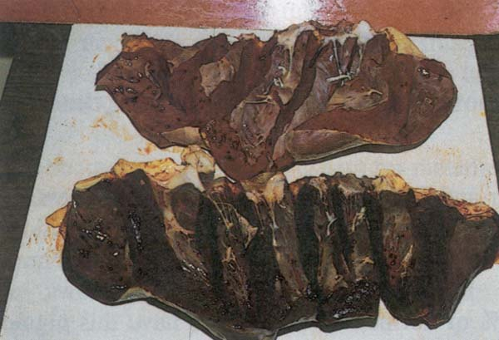
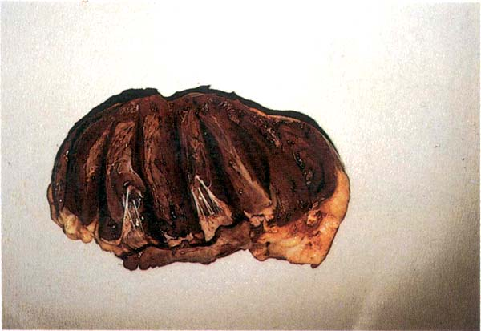
Inspection of heart
• Visual inspection for pericarditis;
• opening of pericardial sac to examine for abnormal amount or appearance of the liquid; and incisions to open all chambers to examine for endocarditis, and for cysticercosis cysts in the septum.

Slide 8
Inspection of diaphragm
If cysticercosis has been found in the cheek muscles or in the heart, the diaphragm must also be inspected.
Genital organs
These are visually inspected and palpated; they are incised only if any abnormality is detected.

Slide 9
Inspection of liver
This organ is particularly important as a general indicator of animal health, as many abnormalities occur in the liver of sick animals:
• visual examination for degenerations, dystrophies, cysts (e.g. hydatid), abscesses, tumours, tuberculous lesions;
• palpation to detect any of the above in deeper tissue, palpation of the hepatic lymph node (and its incision if any abnormalities found); and
• incisions to open the bile ducts (along the main ducts and across the caudal lobe) to examine for liver fluke infestation.

Slide 10
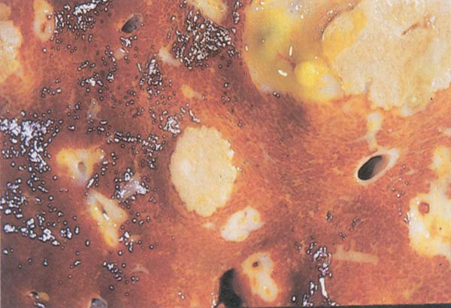
Liver abscesses caused by Fusobacterium necrophorum.

Slide 11
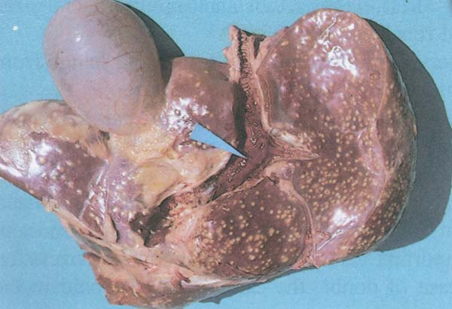
Multiple abscesses in the calf liver as a result of an umbilical infection; carcass with such condition should be condemned.

Slide 12
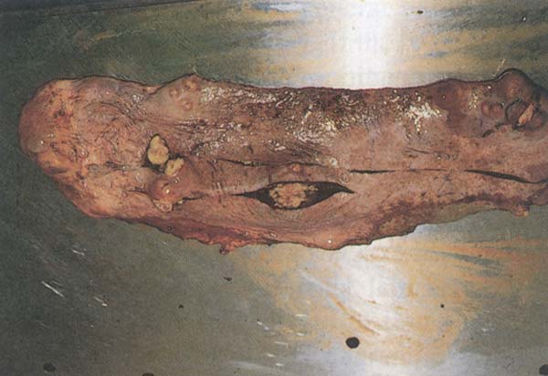
Spleen
The surface and substance of spleen is inspected for anthrax ,tuberculosis or presence of artifacts.

Slide 13
Inspection of alimentary tract
Alimentary tract contents are usually inspected whilst placed in trays, and include oesophagus, rumen and large and small intestines:
• visual inspection of rumen and intestines for enteritis, etc.: salmonellosis and Johnes’ disease both cause redness of the enteric tract, so may be detected by visual inspection;
• palpation of the mesenteric lymph nodes – if any abnormality is detected, these lymph nodes may be incised for further inspection; and
• palpation of oesophagus for parasitic cysts, etc.

Slide 14
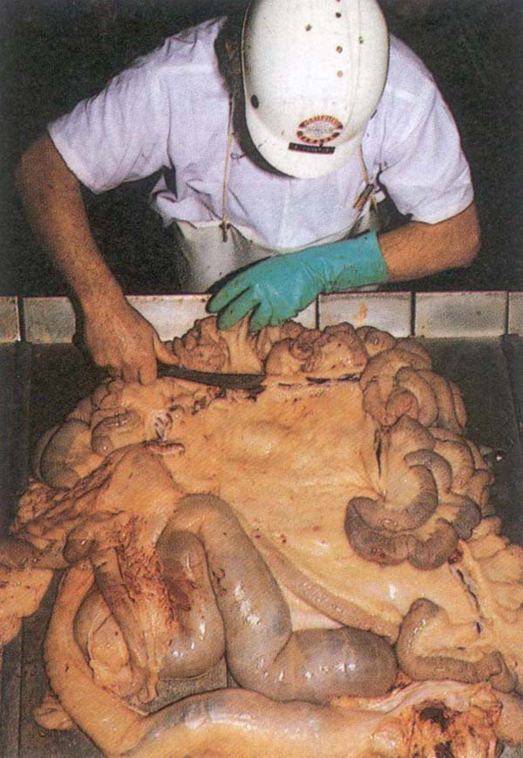
Viewing and incision of the mesenteric lymph nodes. In this case an incision was performed to demonstrate the mesenteric lymph nodes chain.

Slide 15
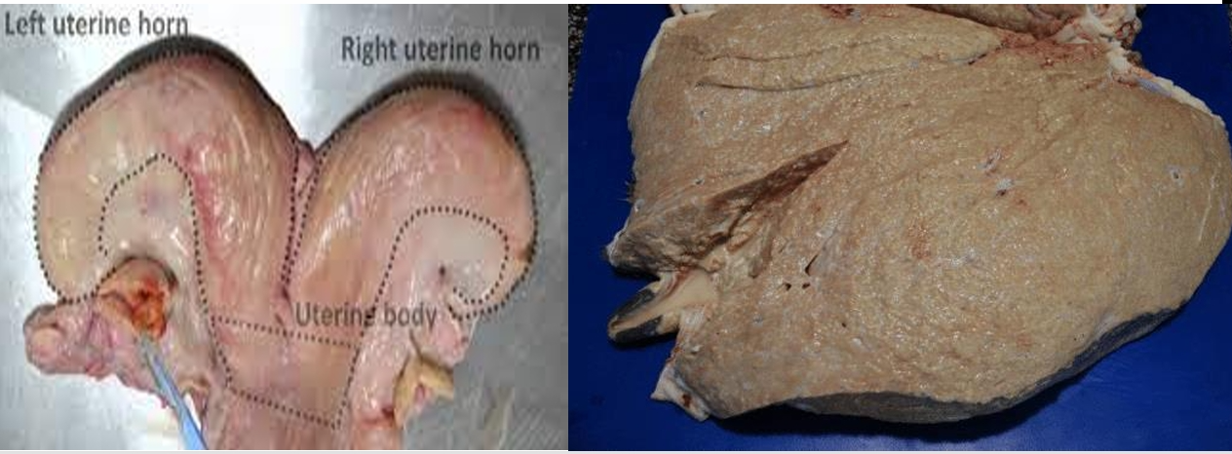
Uterus: Check for septic conditions by viewing, palpating and incising if necessary.

Slide 16
Udder
The udder is examined, visually and by palpation, after it has been separated from the carcass.
Conduct a visual inspection and palpation. Mastitis is frequently caused by zoonotic agents, so care must be taken to avoid milk secretion and spillage, with possible contamination of other edible tissues. Also, tuberculous lesions may be found in the udder.

Slide 17
Examples for Judgement
Some common examples include localized abscesses hydatid cyst in liver
The affected parts must be removed and condemned (appropriately disposed of), while the remaining healthy normal tissues can be fit for human consumption.
liver is unfit for esthetical reasons, although the disease is not transmited to humans .
Positive identification of the viscera must be maintained until a disposition has been made.

Slide 18


